Slide 1

CSE 3002 - Programming in Java Course Type: LP Credits: 3

Slide 2
Unit - 3
Java Exception Handling
Java Exceptions, Java Exception Handling, Java try...catch, Java throw and throws, Java catch Multiple Exceptions, Java Annotations Types.
Multithreading
Introduction, Thread Creations, Thread Life Cycle, Life Cycle Methods, Java Synchronization methods, User-defined packages.

Slide 3
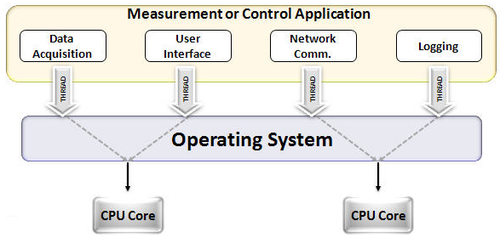
What do you Understand?

Slide 4
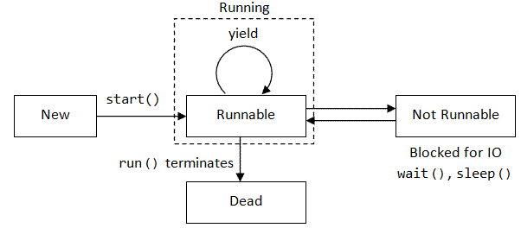
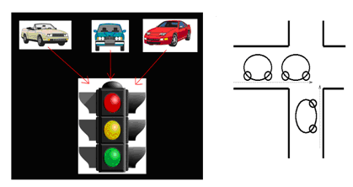
What do you Understand?

Slide 5
Multithreading - Introduction
A multithreaded program contains two or more parts that can run concurrently.
Each part of such a program is called a thread, and each thread defines a separate path of execution. It is a specialized form of multitasking.
Multitasking: process-based and thread-based
Process-based: (A program in execution – process) run two or more programs concurrently
Thread-based: Thread is the smallest unit of dispatchable code.
For instance, a text editor can format text at the same time that it is printing, as long as these two actions are being performed by two separate threads.
Threads are lightweight process. They share the same address space.
Inter-thread communication is inexpensive, and context switching from one thread to the next is low cost.

Slide 6
The Java Thread Model
Single-threaded systems use an approach called an event loop with polling
A single thread of control runs in an infinite loop, polling a single event queue to decide what to do next.
The benefit of Java’s multithreading is that the main loop/polling mechanism is eliminated.
One thread can pause without stopping other parts of your program.

Slide 7
Thread Life Cycle

Slide 8
Thread Priorities
Determines how thread should be treated with respect to the others.
Context switch - A thread’s priority is used to decide when to switch from one running thread to the next thread
The rules that determine when a context switch are
A thread can voluntarily relinquish control: This is done by explicitly yielding, sleeping, or blocking on pending I/O. In this scenario, all other threads are observe, and the highest-priority thread that is ready to run is given the CPU.
A thread can be preempted by a higher-priority thread: In this case, a lower-priority thread that does not yield the processor is simply preempted—no matter what it is doing—by a higher-priority thread. Basically, as soon as a higher-priority thread wants to run, it does. This is called preemptive multitasking.

Slide 9
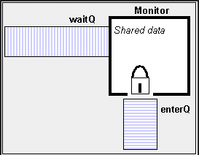
Synchronization
Two threads to communicate and share a complicated data structure, more than one write at a time.
Once a thread enters a monitor, all other threads must wait until that thread exits the monitor.
Once a thread is inside a synchronized method, no other thread can call any other synchronized method on the same object
Messaging
Threads to communicate with each other.
Taken care by Java and not by Operating System.
Allows a thread to enter a synchronized method on an
object, and then wait there until some other thread explicitly notifies it to come out.

Slide 10
Life Cycle Methods
To create a new thread, your program will either extend Thread or implement the Runnable interface.
Can’t directly refer to the real state of a running thread, you will deal with it through its proxy. The Thread class defines several methods that help manage threads.
Method | Meaning
getName | Obtain a thread’s name.
getPriority | Obtain a thread’s priority
isAlive | Determine if a thread is still running.
join | Wait for a thread to terminate
run | Entry point for the thread.
sleep | Suspend a thread for a period of time.
start | Start a thread by calling its run method.

Slide 11
Main Thread
It is the one that is executed when program begins.
The main thread is important for two reasons:
It is the thread from which other “child” threads will be generate.
Often it must be the last thread to finish execution because it performs various shutdown actions. It can be controlled through a Thread object.
To do so, obtain a reference to it by calling the method currentThread( )
A thread group is a data structure that controls the state of a collection of threads as a whole.
static void sleep(long milliseconds) throws InterruptedException
static void sleep(long milliseconds, int nanoseconds) throws InterruptedException
final void setName(String threadName)
final String getName( )

Slide 12
class CurrentThreadDemo
{
public static void main(String args[])
{
Thread t = Thread.currentThread();
System.out.println("Current thread: " + t);
t.setName("My Thread"); // change the name of the thread
System.out.println("After name change: " + t);
try
{
for(int n = 5; n > 0; n--) {
System.out.println(n);
Thread.sleep(1000);
}
} catch (InterruptedException e) {
System.out.println("Main thread interrupted");
}
}}
Current thread: Thread[main,5,main]
After name change: Thread[My Thread,5,main]
5
4
3
2
1

Slide 13
Creating a Thread
Java defines two ways in which this can be accomplished:
implement the Runnable interface
extend the Thread class

Slide 14
1. Implementing Runnable
The easiest way to create a thread. Runnable abstracts a unit of executable code.
We can construct a thread on any object that implements Runnable.
To implement Runnable, a class need only implement a single method called run( )
public void run( )
Inside run( ), you will define the code that constitutes the new thread
run( ) can call other methods, use other classes, and declare variables, just like the main thread can.
The only difference is that run( ) establishes the entry point for another, concurrent thread of execution within your program
Instantiate an object of type Thread by: Thread(Runnable threadOb, String threadName)
Thread will not start running until you call its start( ) method, which is declared within Thread.

Slide 15
class NewThread implements Runnable {
Thread t;
NewThread() {
// Create a new, second thread
t = new Thread(this, "Demo Thread");
System.out.println("Child thread: " + t);
t.start(); // Start the thread
}
// This is the entry point for the second thread.
public void run() {
try {
for(int i = 5; i > 0; i--) {
System.out.println("Child Thread: " + i);
Thread.sleep(500);
}
} catch (InterruptedException e) {
System.out.println("Child interrupted.");
}
System.out.println("Exiting child thread.");
} }
class ThreadDemo {
public static void main(String args[]) {
new NewThread(); // create a new thread
try {
for(int i = 5; i > 0; i--) {
System.out.println("Main Thread: " + i);
Thread.sleep(1000);
}
} catch (InterruptedException e) {
System.out.println("Main thread interrupted.");
}
System.out.println("Main thread exiting.");
}
}
Child thread: Thread[Demo Thread,5,main]
Main Thread: 5 Child Thread: 5 Child Thread: 4
Main Thread: 4 Child Thread: 3 Child Thread: 2
Main Thread: 3 Child Thread: 1
Exiting child thread.
Main Thread: 2 Main Thread: 1
Main thread exiting.

Slide 16
2. Extending Thread
To create a new class that extends Thread, and then to create an instance of that class.
The extending class must override the run( ) method, which is the entry point for the new thread.
It must also call start( ) to begin execution of the new thread.

Slide 17
class NewThread extends Thread {
NewThread() {
// Create a new, second thread
super("Demo Thread");
System.out.println("Child thread: " + this);
start(); // Start the thread
}
// This is the entry point for the second thread.
public void run() {
try {
for(int i = 5; i > 0; i--) {
System.out.println("Child Thread: " + i);
Thread.sleep(500);
}
} catch (InterruptedException e) {
System.out.println("Child interrupted.");
}
System.out.println("Exiting child thread.");
}
}
class ExtendThread {
public static void main(String args[]) {
new NewThread(); // create a new thread
try {
for(int i = 5; i > 0; i--) {
System.out.println("Main Thread: " + i);
Thread.sleep(1000);
}
} catch (InterruptedException e) {
System.out.println("Main thread interrupted.");
}
System.out.println("Main thread exiting.");
} }
Child thread: Thread[Demo Thread,5,main]
Main Thread: 5 Child Thread: 5 Child Thread: 4
Main Thread: 4 Child Thread: 3 Child Thread: 2
Main Thread: 3 Child Thread: 1
Exiting child thread.
Main Thread: 2 Main Thread: 1
Main thread exiting.

Slide 18
This program generates the same output as the preceding version.
As you can see, the child thread is created by instantiating an object of NewThread, which is derived from Thread.
Notice the call to super( ) inside NewThread.
This invokes the following form of the Thread constructor:
public Thread(String threadName)
Here, threadName specifies the name of the thread.

Slide 19
Creating Multiple Threads
class NewThread implements Runnable {
String name;
Thread t;
NewThread(String threadname) {
name = threadname;
t = new Thread(this, name);
System.out.println("New thread: " + t);
t.start();
}
public void run() {
try {
for(int i = 5; i > 0; i--) {
System.out.println(name + ": " + i);
Thread.sleep(1000);
}
}
catch (InterruptedException e) {
System.out.println(name + "Interrupted");
}
New thread: Thread[One,5,main]
New thread: Thread[Two,5,main]
New thread: Thread[Three,5,main]
One: 5
Two: 5
Three: 5
One: 4
Two: 4
Three: 4
.
.
One: 1
Three: 1
Two: 1
One exiting.
Two exiting.
Three exiting.
Main thread exiting.
System.out.println(name + " exiting.");
}
}
class MultiThreadDemo {
public static void main(String args[]) {
new NewThread("One");
new NewThread("Two");
new NewThread("Three");
try {
Thread.sleep(10000);
} catch (InterruptedException e) {
System.out.println("Main thread Interrupted");
}
System.out.println("Main thread
exiting.");
}
}

Slide 20
Using isAlive( ) and join( )
isAlive( ) - to determine whether a thread has finished.
final boolean isAlive( )
The isAlive( ) method returns true if the thread upon which it is called is still running.
It returns false otherwise.
final void join( ) throws InterruptedException
This method waits until the thread on which it is called terminates.
Allows to specify a maximum amount of time that you want to wait for the specified thread to terminate.

Slide 21
Thread Priorities
setPriority( ) – Used to set a thread’s priority, which is a member of Thread.
final void setPriority(int level)
Where level specifies the new priority setting for the calling thread.
The value of level must be within the range MIN_PRIORITY and MAX_PRIORITY. (1 to 10)
To return a thread to default priority, specify NORM_PRIORITY, which is currently 5.
These priorities are defined as final variables within Thread.
getPriority( ) - Obtain the current priority of Thread
final int getPriority( )

Slide 22
Synchronization
When two or more threads need access to a shared resource, they need some way to ensure that the resource will be used by only one thread at a time.
The process by which this is achieved is called synchronization.
A monitor is an object that is used as a mutually exclusive lock, or mutex.
Only one thread can own a monitor at a given time.
When a thread acquires a lock, it is said to have entered the monitor.
All other threads attempting to enter the locked monitor will be suspended until the first thread exits the monitor.
These other threads are said to be waiting for the monitor.
A thread that owns a monitor can reenter the same monitor if it so desires.

Slide 23
Synchronization
Shared Resource
Thread T1
(LOCK)
Thread T2
(Suspended)
Thread T1
(Suspended)
Reenter

Slide 24
Synchronized Methods
To enter an object’s monitor, just call a method that has been modified with the synchronized keyword.
While a thread is inside a synchronized method, all other threads that try to call it (or any other synchronized method) on the same instance have to wait.
To exit the monitor and relinquish control of the object to the next waiting thread, the owner of the monitor simply returns from the synchronized method.

Slide 25
The synchronized Statement
Want to synchronize access to objects of a class that was not designed for multithreaded access.
That is, the class does not use synchronized methods.
synchronized(object)
{
// statements to be synchronized
}
Here, object is a reference to the object being synchronized.
A synchronized block ensures that a call to a method that is a member of object occurs only after the current thread has successfully entered object’s monitor.

Slide 26
Mind Map
Implementing Runnable
Extending Thread
Synchronization
Messaging
Main Thread
Creating a Thread
Thread Priorities
Thread Class and the Runnable Interface
Multithreaded Programming
Synchronized Methods
Synchronization
isAlive( ) and join( )
Creating Multiple Threads
synchronized Statement

